Slide 1
Social change in modern India
Module 4-part II

Slide 2
Social changes in India
Social systems are always in the process of change.
Contemporary Indian society is changing rapidly .
This change is taking place both in structure and functioning. Social institutions and values are changing in India.
Such as caste, family, marriage system, village community changing Into important respects.

Slide 3
Westernization
Otherwise known as Europeanization or occidentalization meaning western world.
It is a process of all cultural changes and institutional innovations in India as this country came into political and cultural contact with the western nations especially Britain. Acculturation and enculturation
Changes occurring in technology, institutions, ideology and values.
Westernization includes a scientific approach, emphasis on materialism rather on spiritualism, individualism, liberal approach towards various problems of society, humanism, equality.

Slide 4
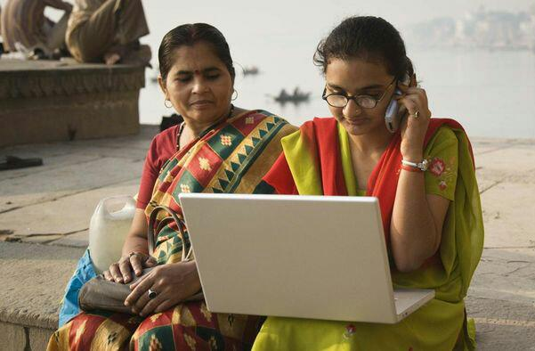
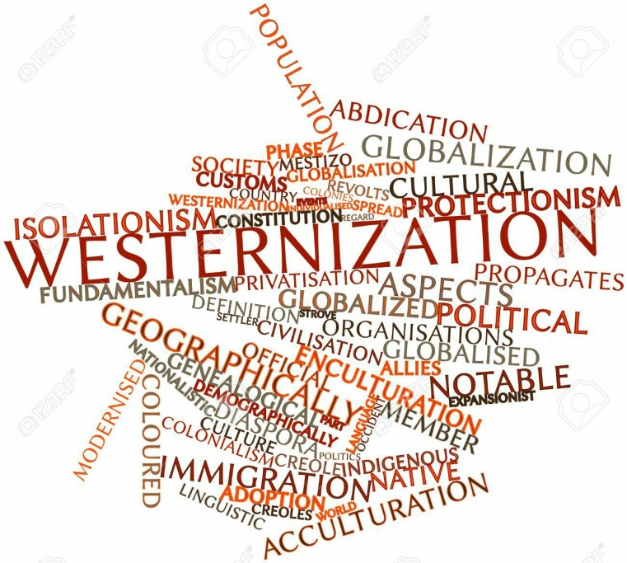
Impact of westernization
Influenced on caste system
Promotion of social reform movements
Economic sphere: industry, land management, variety in cultivation, market economy, new economy policy, globalizations
Political sphere: promotion of democratic values and ideals, social justice, national consciousness
Increase in westernization accelerates the process of sanskritization
e.g. many high castes people those are exposed to westernization through English education are seen giving up their traditional life style and caste rites

Slide 5

Modernization
Dominant theme after second world war 1950s and 60s
Central concept in the sociology of development, refering to the interactive process of economic growth and social change.
Modernization deals with the effects of economic development on traditional social structures and values. Related to industrialization.
According to some scholar Modernization is the child of westernization.
Learner (1958) three features constitute the core of modernized personality- empathy, mobility and high participation.
Empathy is the capacity to see things as others see them. All societies posses this capacity in some measure, but to sharpen and strengthen, it can make qualitative change in human interaction. Such a change is desired in modernized societies.

Slide 6
The second attribute, mobility does not refer only to geographical mobility it is used in a more comprehensive sense. The imperatives of change demand a capacity to assume as occasions demand new statuses and learn to play associated roles.
The third attribute, high participation refers to the increased role of individuals in realizing social goals and objectives in more active ways. High participation requires the capacity in individuals to visualise new goals or altered objectives and modify their roles accordingly.
Modernized societies operate through institutional structures that are capable of continuously absorbing the changes that are inherent in the process of modernization.

Slide 7
Impact of modernization
Regional imbalances
Benefits of modernization appear to have received little serious thought.
Growing rich and poor gap. Growing elitism and less humanitarian.
Rampant corruption and nepotism (regionalism). Rising tied of religious communalism and fundamentalism e.g. Babri masjid-Ram Janmabhomi dispute and other recent communal violence.
On the contrary modern Indian society is more scientific society.

Slide 8
Secularization
Intimately related to westernization. It is the transformation of a society from religious to nonreligious values and secular institutions.
Got imputes during British rule
The rise of nationalism and national movements for freedom gave further imputes to secularization.
To give freedom of religion to everyone and for equality of religion, India was declared a secular country.
Word Secular was added into the preamble by 42nd amendment 1976 to bring equality to all religions in India
Secularization is the by-product of westernization and sanskritization

Slide 9
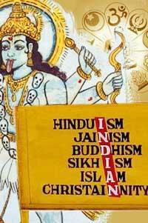
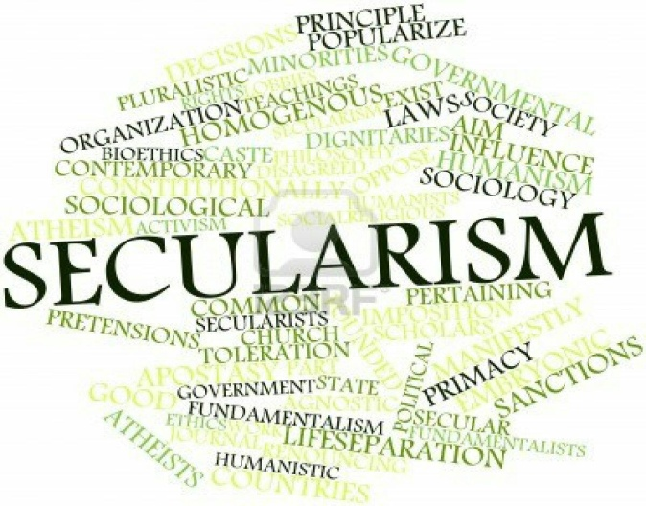
Secularization in modern India
Religious fanaticism and revivalism in India e.g. BJP-RSS ideology on Hindu Rashtra
Secularization has appealed more to urban people and educated class.
India’s concept of secularism where national religious laws suppressed state laws and the state is expected to even handedly involve itself in religion is a controversial subject.
Any attempts and demand by the Indian populace to a uniform civil code is considered a threat to right to religious personal laws by Indian Muslims.
Example Shah Bano case

Slide 10
Democratization
Democracy been very important aspects of social change and modernization in India and democratization have
Adoption of adult and universal franchise was a revolutionary step forward in the path of democratization.
Adult franchise: All adults have the right to elect their representatives, the right of vote is called franchise, equality is the basic principle of democracy.
Legal abolition of untouchability.
Reservation of seats for STs, SCs and OBCs in all legislatures improvement of under privileged communities.

Slide 11
Democracy guarantees some basic rights and freedom for individuals and its voters. These rights are known as fundamental rights. India is the biggest democracy in the world, with a population of over one billion. India, a union of states, is a sovereign socialist, secular, democratic, republic, with a parliamentary system of government.
India’s turn to “illiberal democracy” has laid bare the ruptures inside Prime Minister Modi’s majoritarian politics. The very lifeblood of his political constituency is the activation of a muscular Hindu identity, an identity shaped in stark opposition to Nehruvian India in more ways than one.

Slide 12
References
https://www.thehindu.com/news/national/hindutva-leaders-raise-questions-on-secularism/article7678581.ece
http://www.iimrohtak.ac.in/wp-content/uploads/2011/09/dbm2010.pdf
http://prekshaa.in/effects-of-westernization-on-indian-culture-and-traditions-arts-lifestyle-clothing-food-festivals-rituals-religion-practices-language/#.W3T9n7h9jIU

